Slide 1


Automating .NET Core WEB API Deployment with GitHub Actions
A Beginners guide to building event driven continuous integration and delivery pipelines for .NET core Web API
Mandar Dharmadhikari

Slide 2

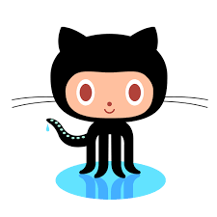


Who am I?
fullstackmaddy
@fullstackmaddy
Business and Integration Architecture Associate Manager at Accenture India
Integration and All things Blazor fan
Blogger at https//fullstackmaddy.github.io
Budding Pianist
Seasoned cook and foodie
https://au.linkedin.com/in/mandar-dharmadhikari

Slide 3
Takeaways from the Session
The What and The Why of GitHub Actions
Basic Concepts of GitHub Actions
Typical CI and CD(delivery) flow for .Net Core WEB API
Demo (The How)
Reading Resources

Slide 4
The What
GitHub Actions are the event driven workflows defined on GitHub repositories
Can be configured to trigger on one or multiple events that occur on a repository
Provide a simple way to automate many tasks right from CICD pipelines to release management and administration
Work with Pay as You Go structure (public repo gets free execution)
Notes:
When a developer or an administrator performs an action on the repository, it triggers some event in the back ground e.g. when a dev pushes a change to a feature branch or an admin merges pull requests.
We can make the workflow trigger on multiple events e.g. we can have same workflow deploy a web app to staging resource group when there is a push or pull request on the staging branch
As we will see later, writing GitHub Actions is breeze, so we can set up multiple workflows to cater to CICD processes and also other admin processes like archiving old branches, managing releases etc
ProductStorageMinutes (per month)GitHub Free500 MB2,000GitHub Pro1 GB3,000GitHub Free for organizations500 MB2,000GitHub Team2 GB3,000GitHub Enterprise Cloud50 GB50,000

Slide 5
The Why
Tight Integration with GitHub repositories
Easy to set up
Can be configured using simple .yaml files
Plethora of inbuilt as well as community actions to automate tasks
Notes:
GitHub has a lot of community created actions which we can use directly in our workflows. This reduces our work to set up the workflows
We can also write our own actions if needed.

Slide 6
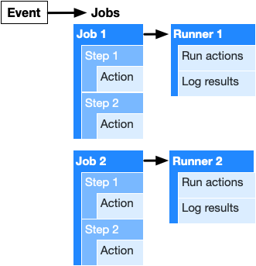
Anatomy of A GitHub Actions Workflow
Notes:
When the interested event occurs the GitHub Action workflow instance is started.
The action contains one or multiple jobs
Each job can contain a single or set of multiple steps that are executed (which are executed sequentially or conditionally). By default, a workflow with multiple jobs will run those jobs in parallel. You can also configure a workflow to run jobs sequentially.
Each step corresponds to a unit of work that will be performed. The step can execute an action(multiple) e.g. checking out the repository or it can execute commands like cmd or bash . Clubbing steps together in a job allows them to share data like environment variables, outputs etc.
Each job runs on a Virtual Machine called a runner.
We can segregate various tasks to run under various jobs, though this will require a careful designing as multiple jobs cannot share environment variables results etc. We can use the GitHub hosted runners which come as Windows, Linux or macOS based runners. We can host our own runners as well, though I am yet to try that out.

Slide 7
A Typical CICD Flow

Slide 8
Demo

Slide 9

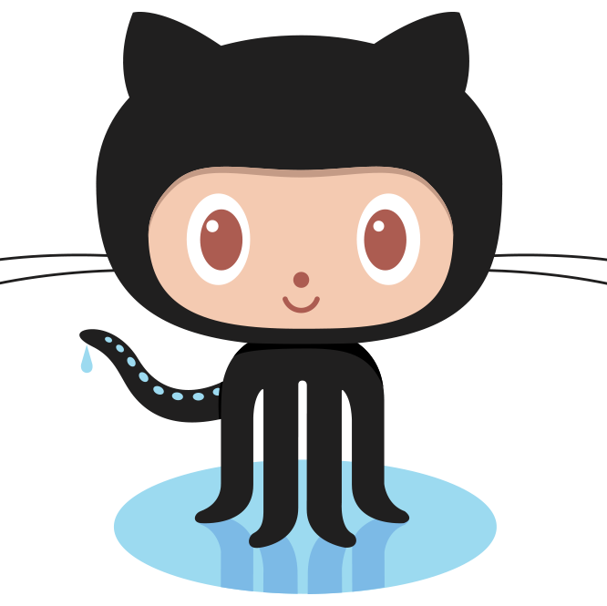
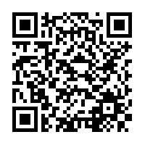
Repository
https://github.com/fullstackmaddy/web-api-cicd-githubactions

Slide 10
Reading Resources
https://docs.github.com/en/actions

Slide 11



